Slide 1
Twitter sentiment analysis on Crypto Currency
- Can Twitter be used as an indicator on crypto currency value and fluctuation?

Slide 2
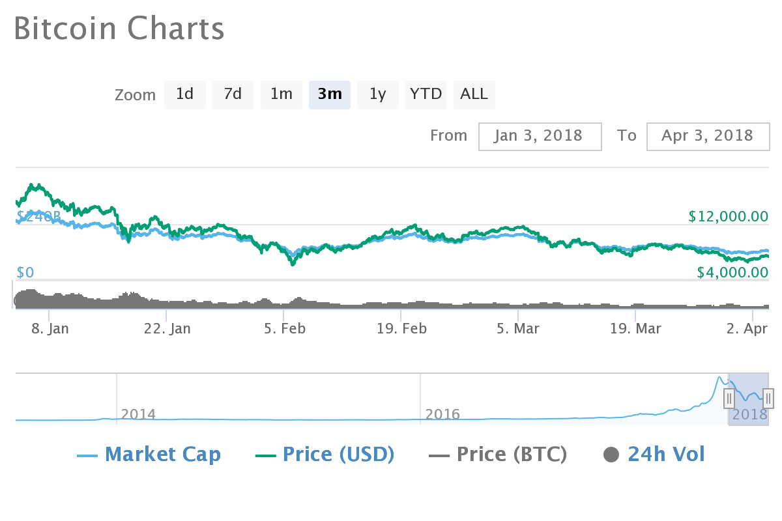
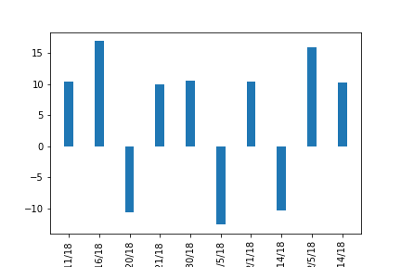
BitCoin
BitCoin total market cap approx. 45%
Highly volatile

Slide 3
Twitter Sentiment Analysis

Slide 4
Influencers?

Slide 5
Conclusion/Way Fwd.

